Slide 1
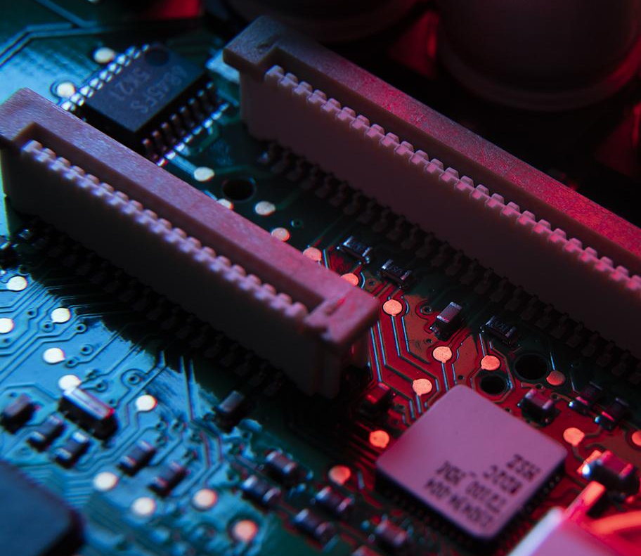
Washing Machine
Presented By: Team (7)

Slide 2

01
Review & Objective

Slide 3
What is Washing Machine Project?
Various real-life scenarios can be represented by Finite State Machines like control system of an automatic washing machine.
Assigning the main stages of the process like Close door, fill water, add detergent, cycle, drain and spin various states that can be implemented as a State Machine.
Writing a test bench to observe the working of the machine.

Slide 4

02
State Diagram

Slide 5
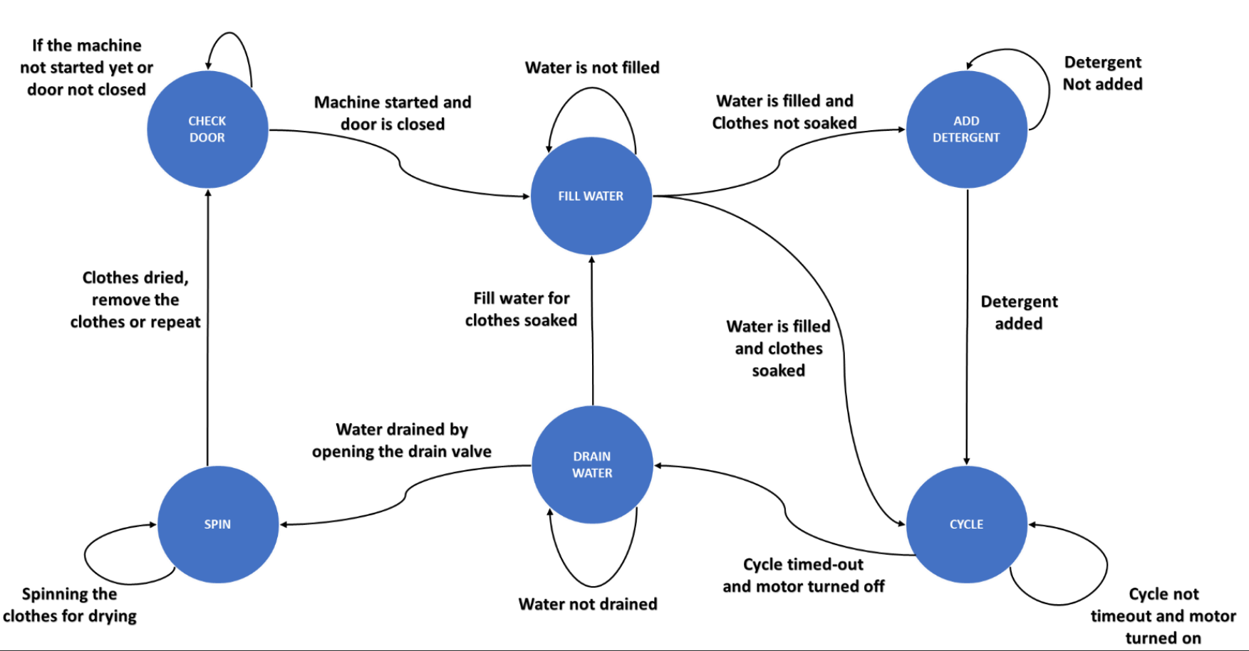

Slide 6
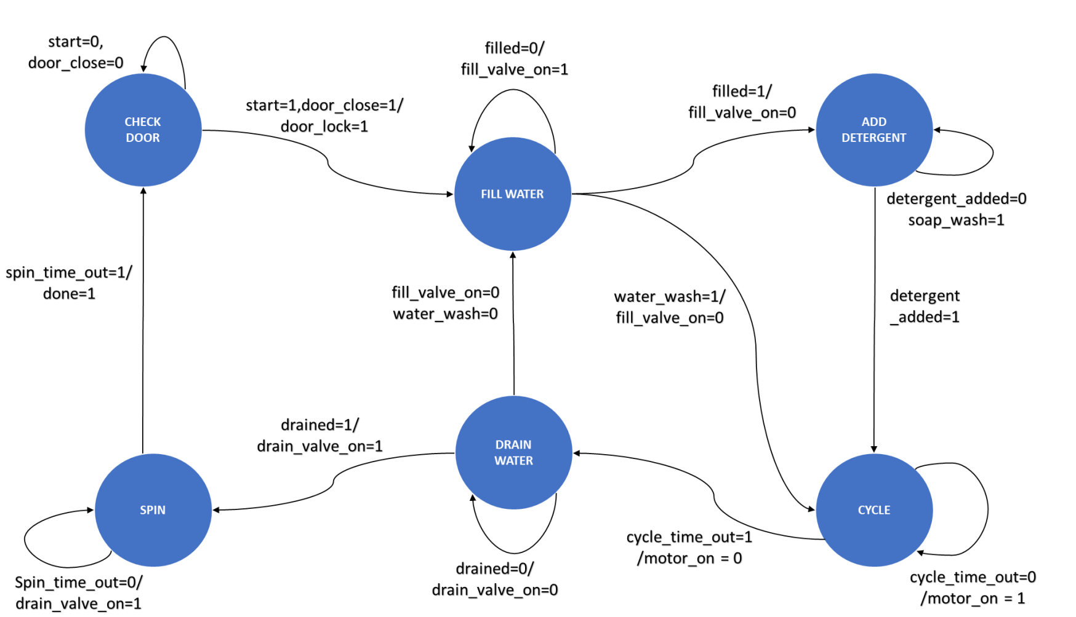

Slide 7
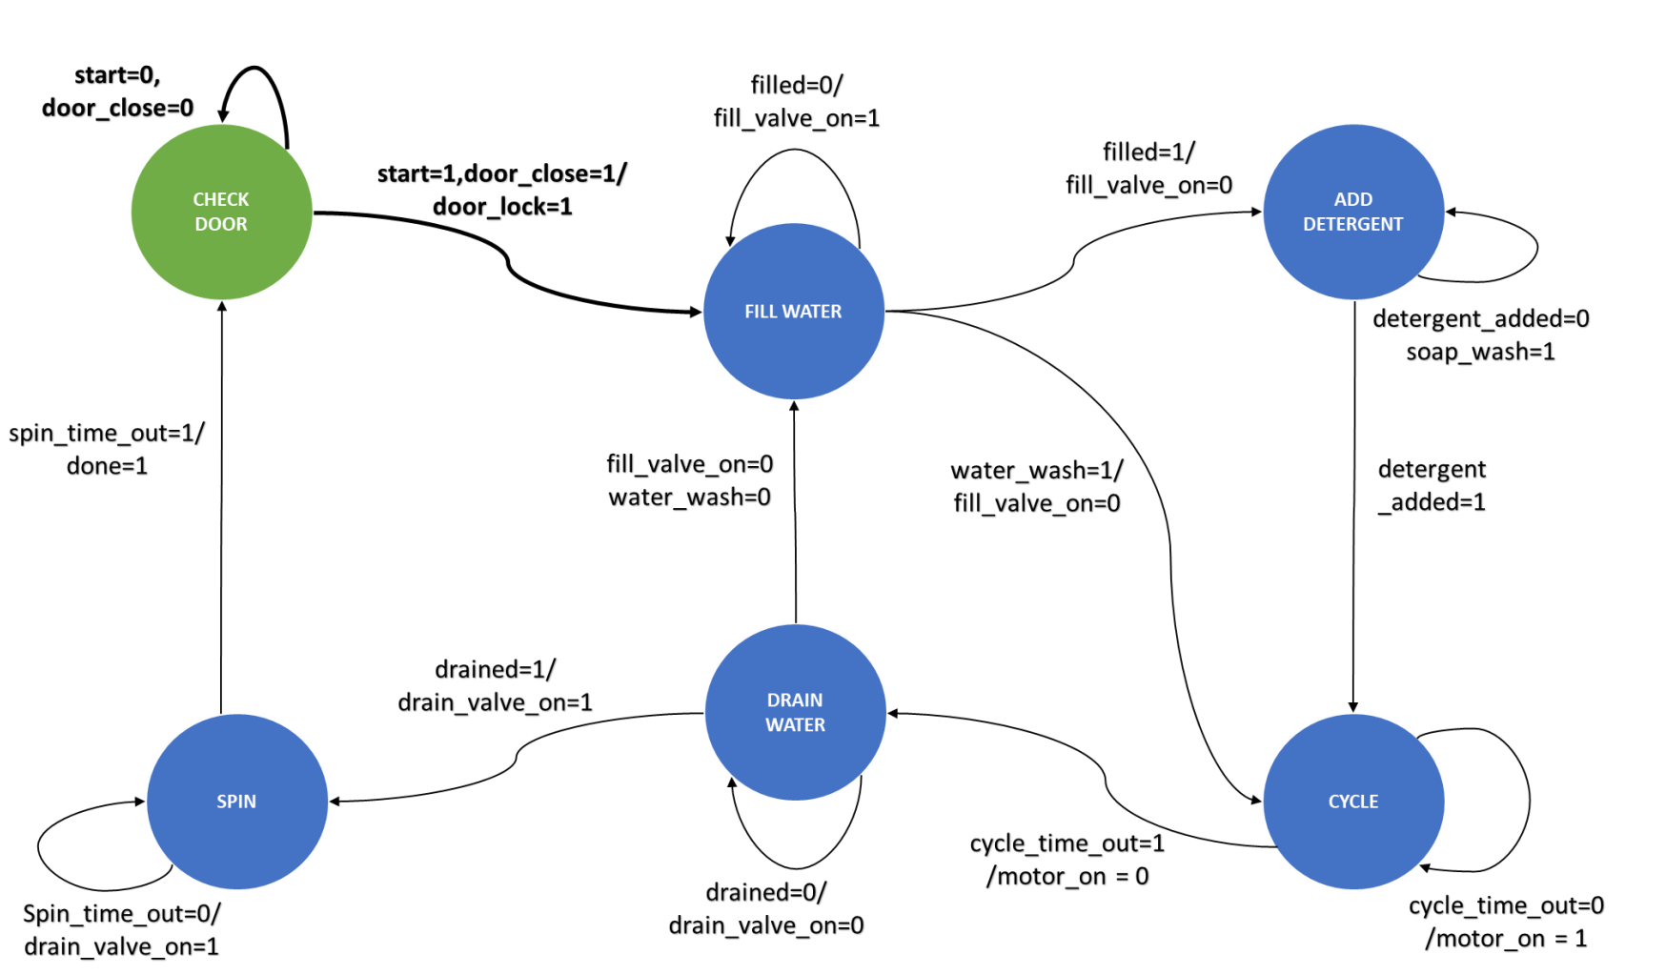

Slide 8
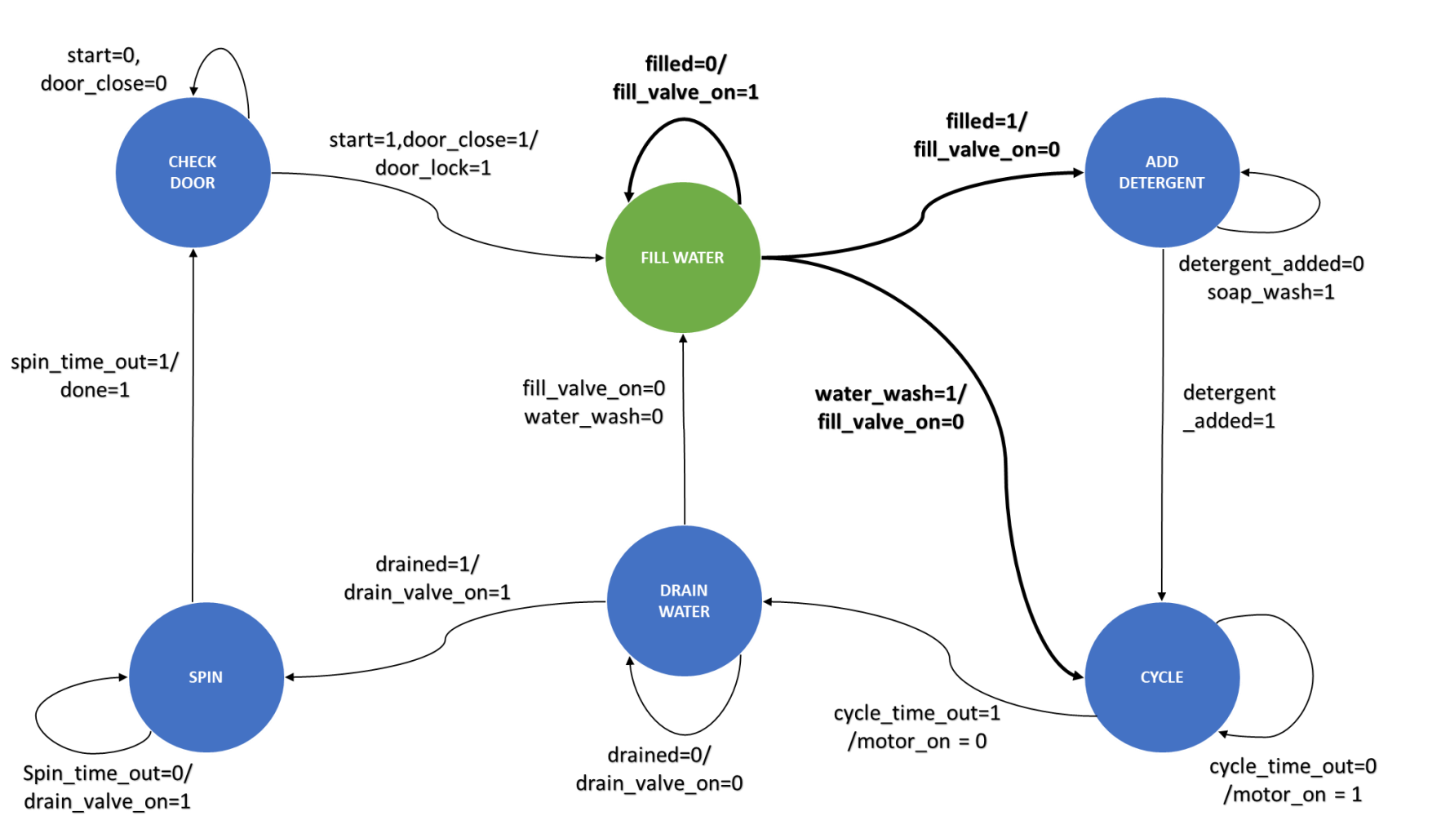

Slide 9
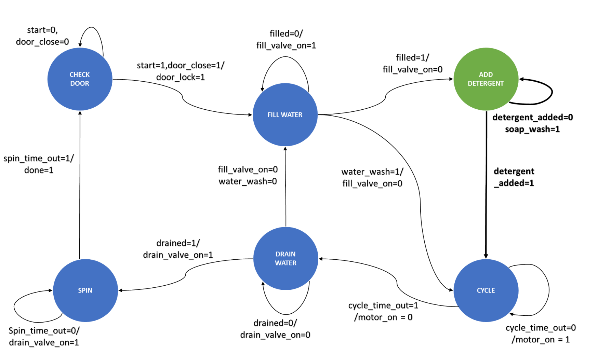

Slide 10
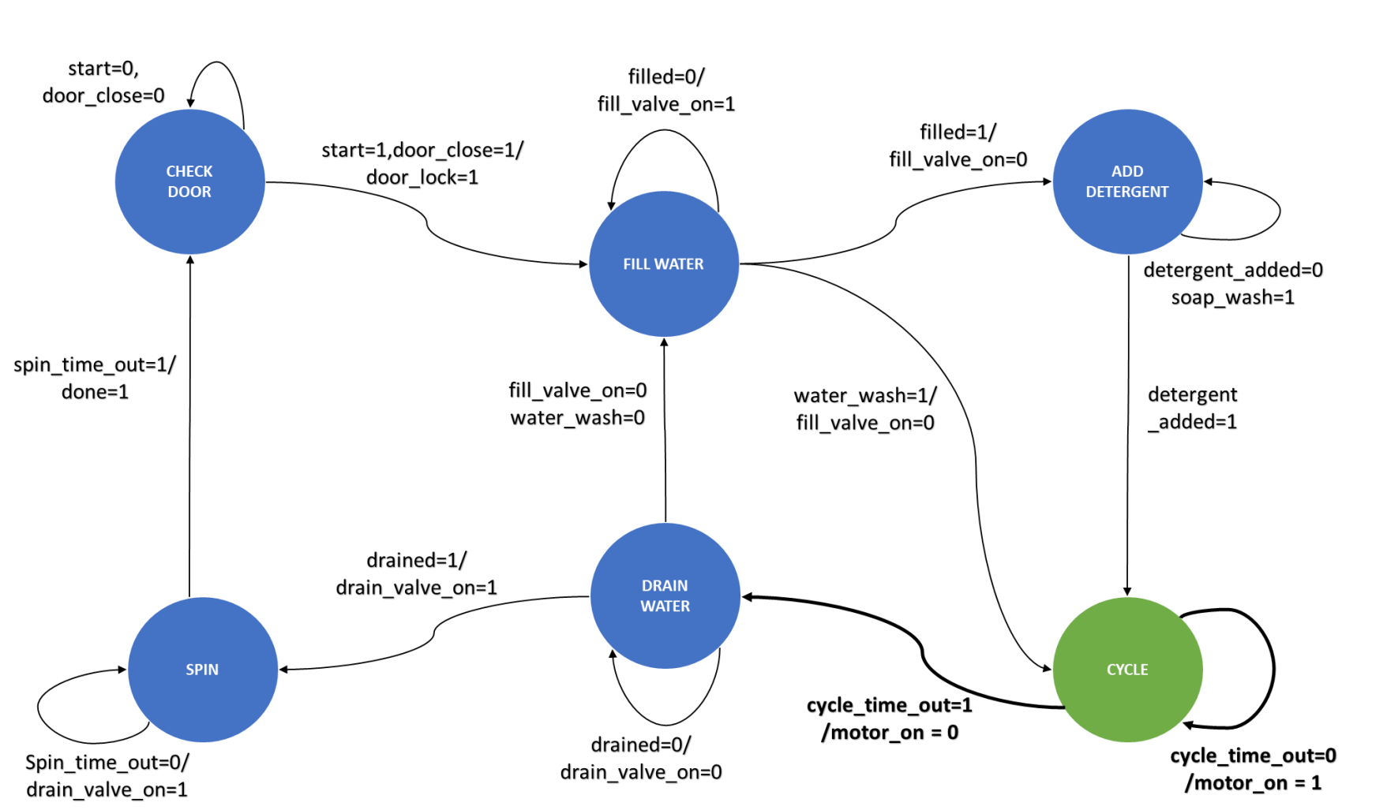

Slide 11
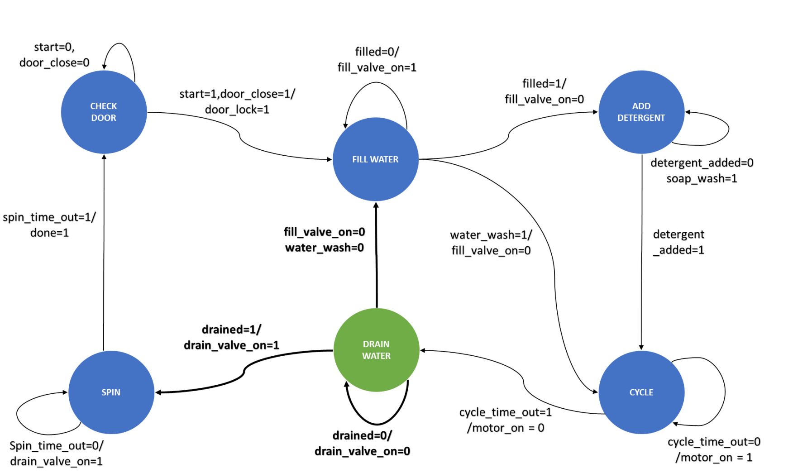

Slide 12
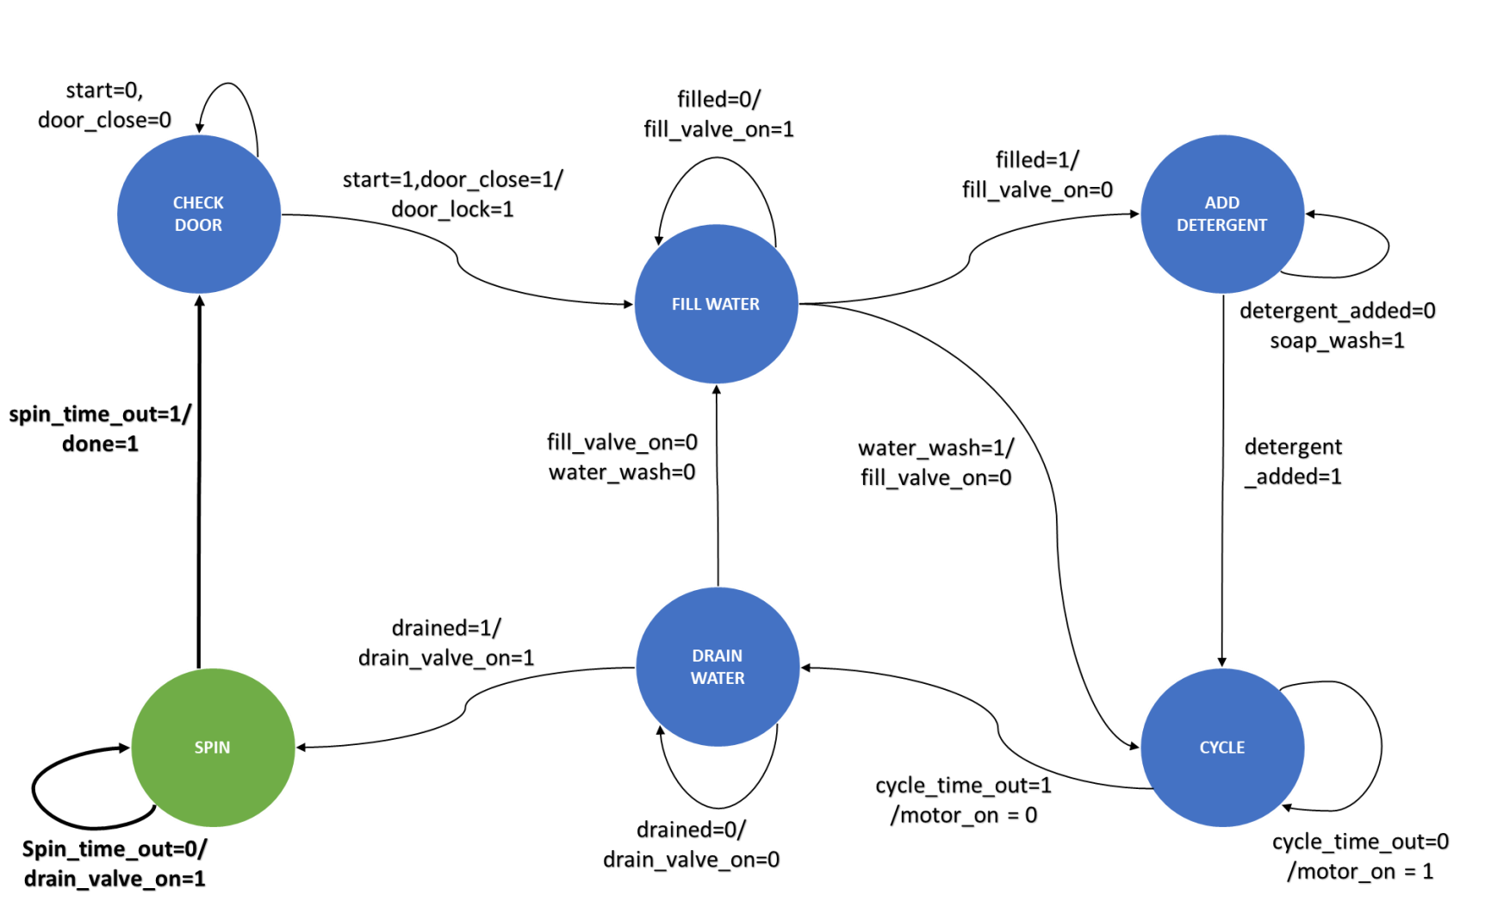

Slide 13

03
Code

Slide 14
04
Testbench

Slide 15
05
Challenges

Slide 16
Challenges
We did a great effort to fined a Finite State Machine Project
The Old Version of Software we used (Modalism)
Some Problems in Wave of our project
Modalism Software (Normal Version) is not able to save our data

Slide 17
Team 7
Ahmad Mahmoud Mohamed Sec.1 - BN.6
Fady Mohsen Magdy Sec.1 – BN.48
Shehab Mohamed Sec.1 – BN.33
Mirna Abdel-Moez Sec.2 – BN.35

